Slide 1
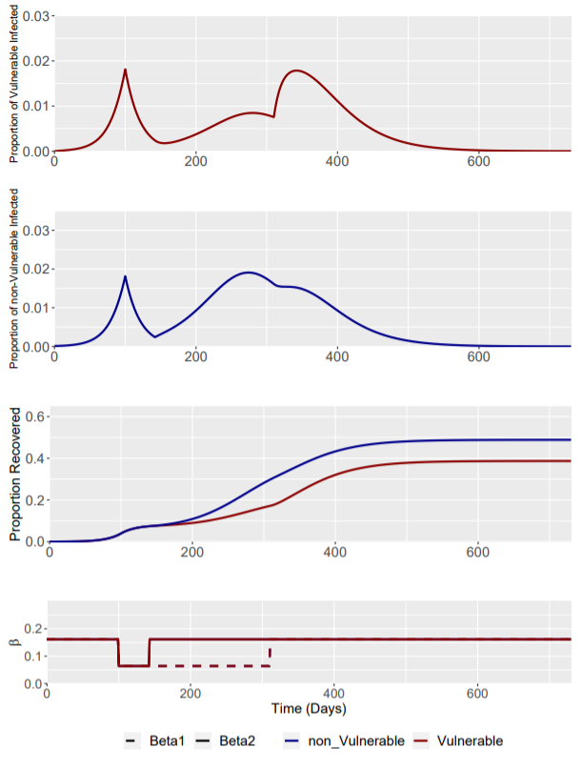
Baseline Scenario: Phase 2 β1 = 0.064
Phase | Weeks | Beta1 | Beta2
0 | Up to I(t) = 0.0182 | 0.161 | 0.161
1 | 0-6 | 0.064 | 0.064
2 | 6-30 | 0.064 | 0.161
3 | 30 onwards | 0.161 | 0.161
β1 remains static at 0.064 throughout the phase 1 and 2 of the intervention.
This is the baseline model for the enhanced shielding intervention.
Intervention trigger is at I(t) = 0.0182

Slide 2
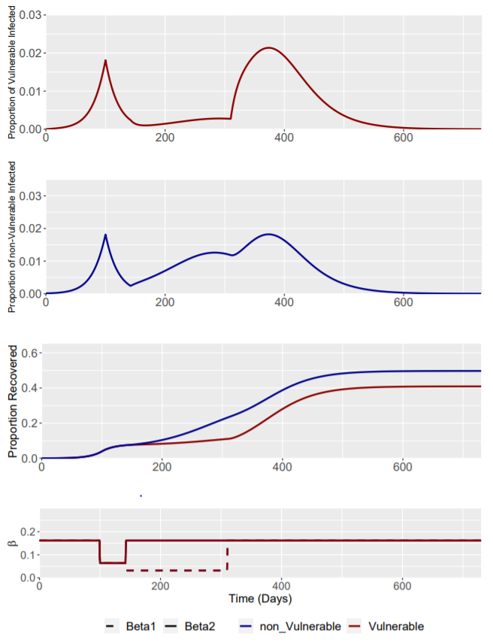
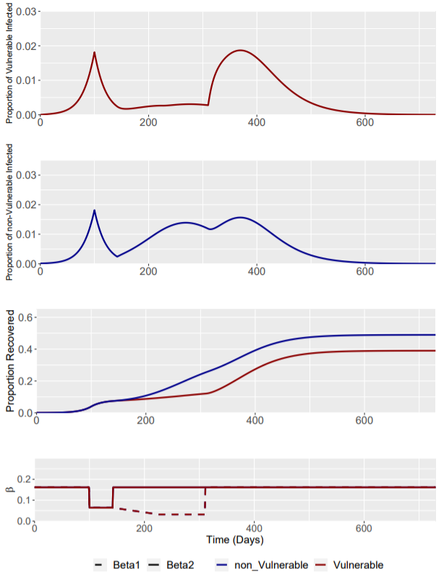
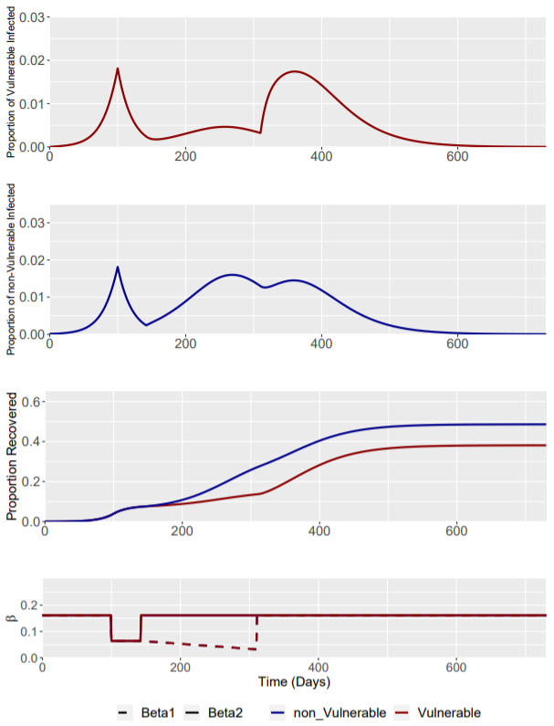
Scenario: Phase 2 β1 = 0.032
Phase | Weeks | Beta1 | Beta2
0 | Up to I(t) = 0.0182 | 0.161 | 0.161
1 | 0-6 | 0.064 | 0.064
2 | 6-30 | 0.032 | 0.161
3 | 30 onwards | 0.161 | 0.161
3 Phase 2 interventions are explored:
Constant Phase 2 β1 intervention at 0.032 for 24 weeks
“Ramp-up” 1 Phase 2 intervention with β1 linearly reduced to 0.032 by week 12 and remaining static at 0.032 for the remaining 12 weeks of phase 2
“Ramp-up” 2 Phase 2 intervention linearly reducing β1 to 0.032 throughout the 24 week intervention, reaching 0.032 at week 24
Phase 2: Constant
Phase 2: “Ramp up” 1
Phase 2: “Ramp up” 2

Slide 3
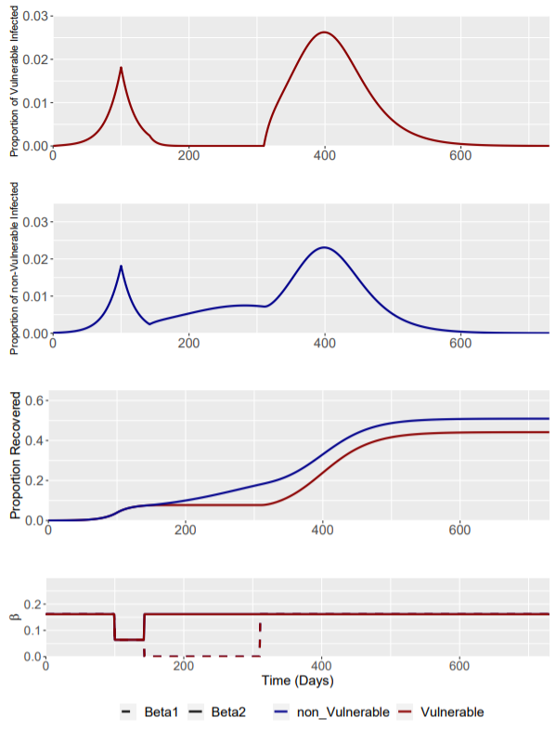
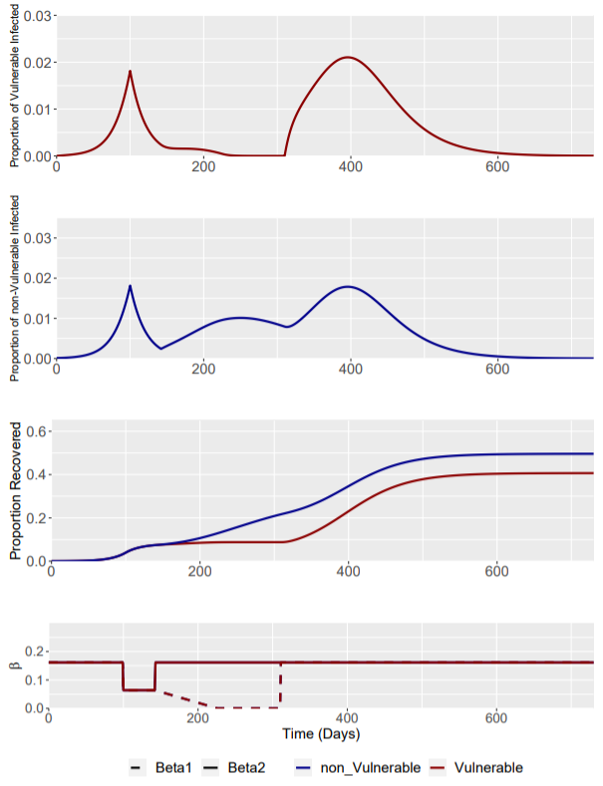
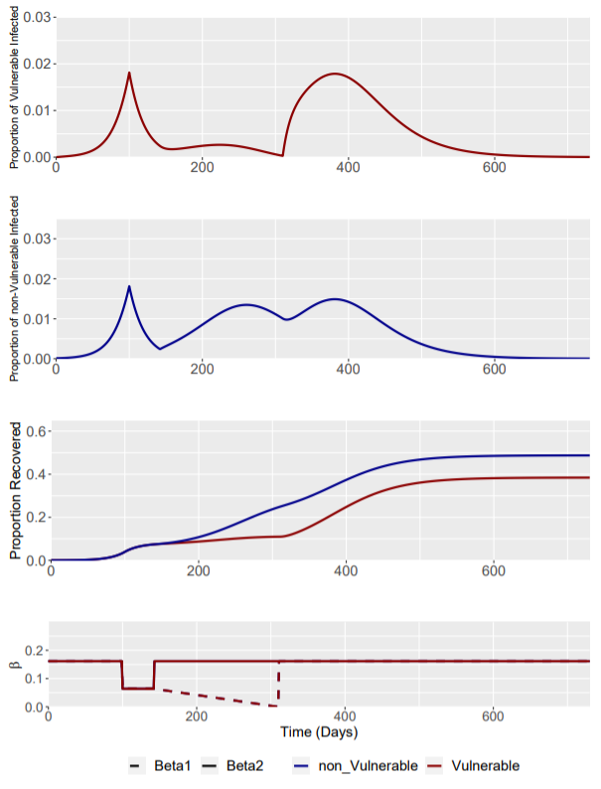
Scenario: Phase 2 β1 = 0
Phase | Weeks | Beta1 | Beta2
0 | Up to I(t) = 0.0182 | 0.161 | 0.161
1 | 0-6 | 0.064 | 0.064
2 | 6-30 | 0 | 0.161
3 | 30 onwards | 0.161 | 0.161
3 Phase 2 interventions are explored:
Constant Phase 2 β1 intervention at 0 for 24 weeks
“Ramp-up” 1 Phase 2 intervention with β1 linearly reduced to 0.032 by week 12 and remaining static at 0 for the remaining 12 weeks of phase 2
“Ramp-up” 2 Phase 2 intervention linearly reducing β1 to 0.032 throughout the 24 week intervention, reaching 0 at week 24
Phase 2: Constant
Phase 2: “Ramp up” 1
Phase 2: “Ramp up” 2

